Slide 1
Factor Rotation Strategy Midterm Update
Practice of QCF
Crist, Hills, Mitchell, Nechtman

Slide 2
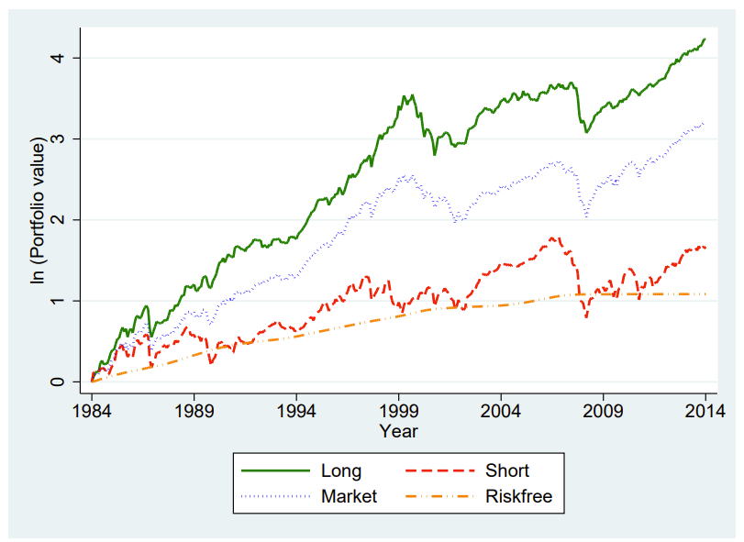
Reference Paper
“Does History Repeat Itself? Business Cycle and Industry Returns”, Journal of Monetary Economics
Chava, Hsu and Zeng
Measures RSR’s (regime Sharpe ratios) of equity sectors in different economic regimes
Creates a L/S rotation strategy based on high and low RSR’s in different regimes, with the belief that changes in expected cash flows creates price differentials between sectors
Generated excess returns of 8.45% and 14.02% alpha in the Fama-French five-factor model

Slide 3
Project Abstract
Analyze the Fama-French five Factor model to evaluate if there is enough diversification for a trading strategy
Build a robust model to measure the economic cycle in a robust way
Use the economic cycle model as a signal for a long/short trading system using the FF 5 factors
Seek to replicate the Reference Paper with a few differences
Factors instead of sectors
See if certain factor premiums are specific to certain economic regimes
Robust economic cycle model
A dynamic predictive model that has a higher signal frequency than annually
Trade optimization
Evaluate different trading optimization techniques rather than just RSR’s

Slide 4
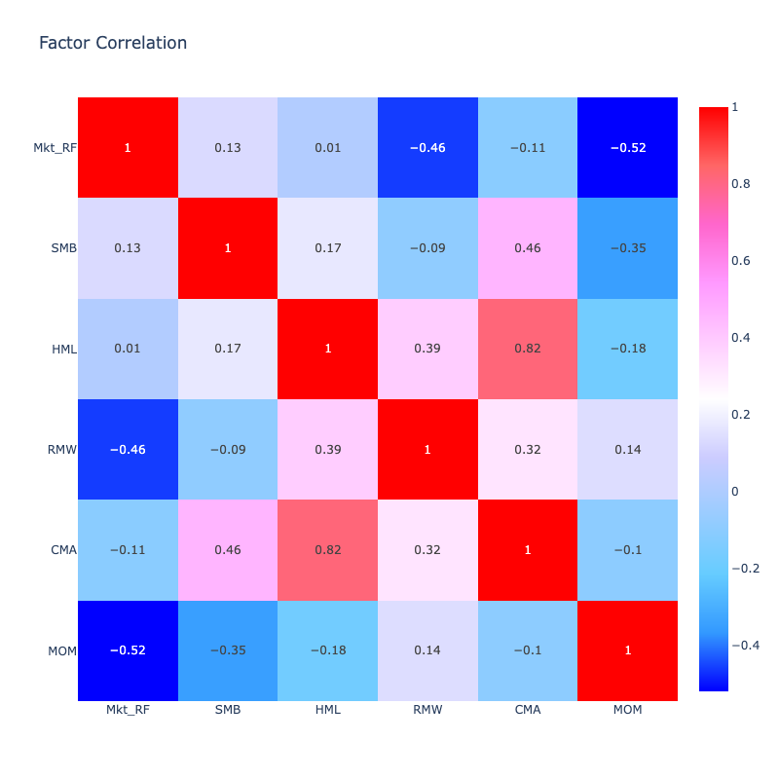
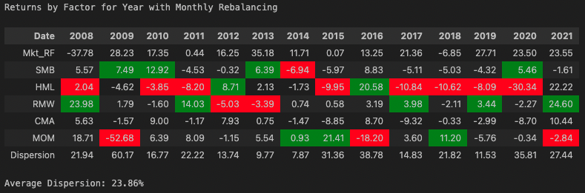
Factor Analysis
The high factor dispersion demonstrates the Alpha potential through factor rotation
The negative correlation amongst factors suggest there is also directionality to this dispersion where pairs trading can be profitable

Slide 5
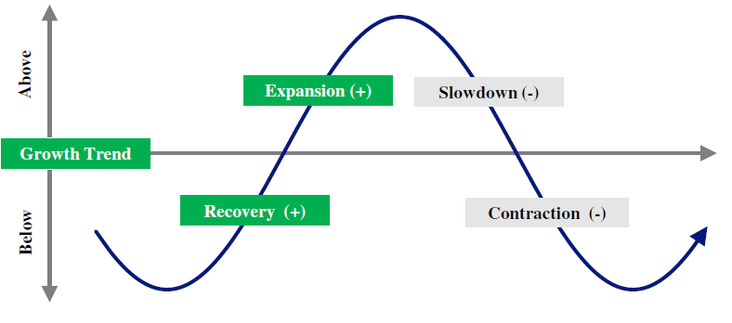
GDP-CPI Model
Quarterly Lagged
Rotation frequency also quarterly so stuck with factor for longer period if regime changes
Took best factor in each cycle with respect to mean return, VaR, expected Sharpe ratio.

Slide 6
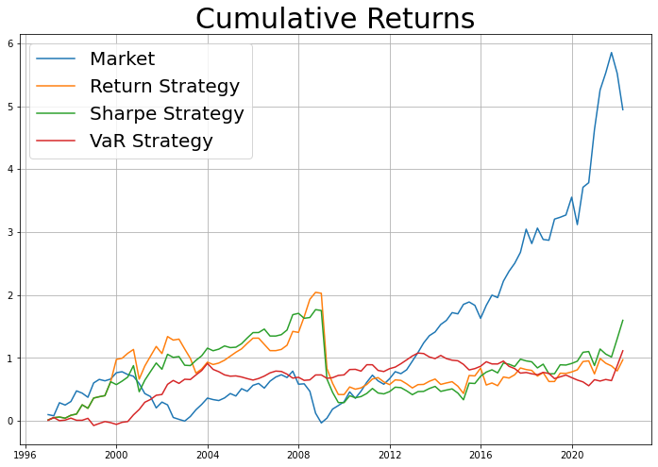
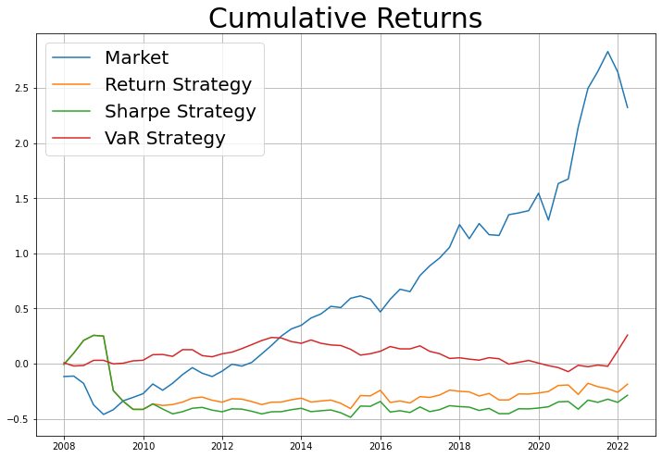
GDP-CPI Model - Performance
Fit On Entire Data
Trained over multiple periods in first half then tested on 2nd half
Strategy | Return | Vol | Sharpe
Market | 7.24% | 14.64% | 0.49
Return | 2.69% | 15.98% | 0.17
Sharpe | 3.81% | 15.02% | 0.25
VaR | 2.97% | 7.92% | 0.38
Strategy | Return | Vol | Sharpe
Market | 8.46% | 15.05% | 0.57
Return | -1.41% | 16.53% | -0.09
Sharpe | -2.30% | 16.86% | -0.14
VaR | 1.60% | 7.29% | 0.22
Notes:
Entire data:
Return Strategy for cycle 1-4: ['HML', 'SMB', 'Mom', 'Mom']
Sharpe Strategy for cycle 1-4: ['HML', 'SMB', 'CMA', 'Mom']
Var Strategy for cycle 1-4: ['CMA', 'CMA', 'CMA', 'CMA']
Test on 2nd half:
Return Strategy for cycle 1-4: ['SMB', 'SMB', 'Mom', 'RMW']
Sharpe Strategy for cycle 1-4: ['SMB', 'SMB', 'RMW', 'RMW']
Var Strategy for cycle 1-4: ['CMA', 'CMA', 'CMA', 'CMA']

Slide 7
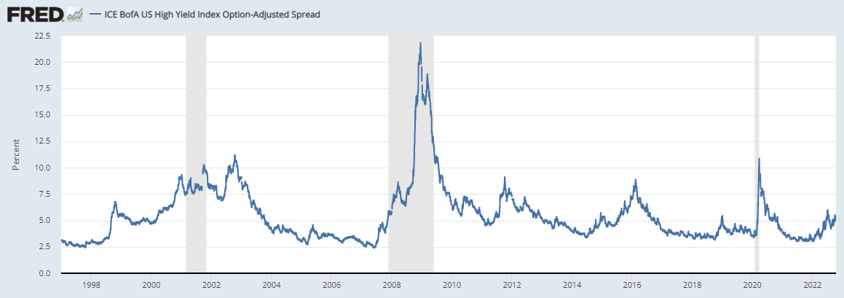
High Yield Model
Replicating of the Verdad Capital Model
Can see the improvement over the GDP on same time frames but still not as effective as investing in the market
May need to diversify factors to not get crushed by a bad performing one
Not a lot of data on the spreads for high yield only going back to 1996

Slide 8
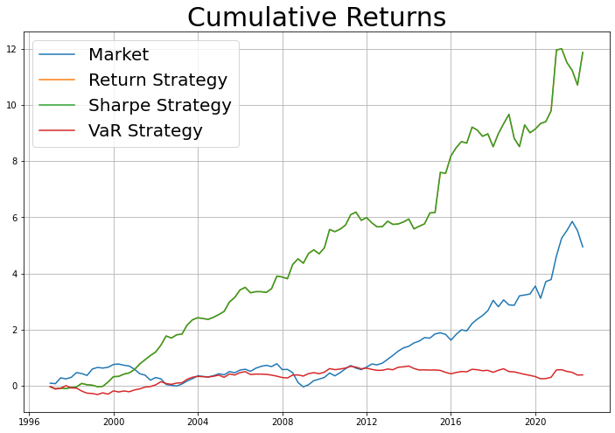
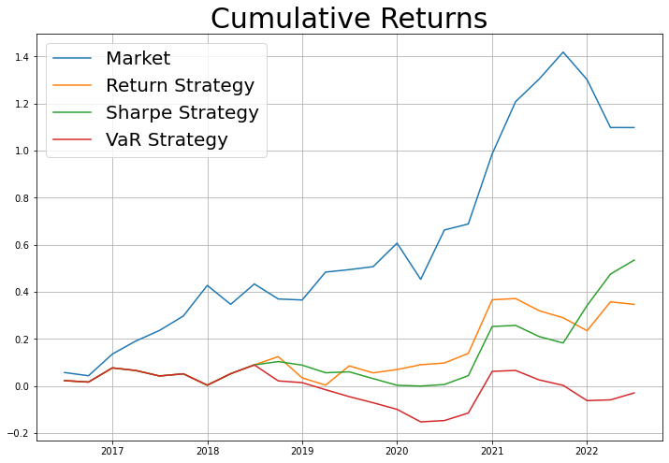
High yield Qtrly - Performance
Fit On Entire Data
Trained over multiple periods in first half then tested on 2nd half
Strategy | Return | Vol | Sharpe
Market | 7.24% | 14.64% | 0.49
Return | 10.54% | 11.1% | 0.95
Sharpe | 10.54% | 11.1% | 0.95
VaR | 1.3% | 10.49% | 0.12
Strategy | Return | Vol | Sharpe
Market | 12.59% | 13.63% | 0.92
Return | 4.88% | 11.36% | 0.43
Sharpe | 7.1% | 11.37% | 0.62
VaR | -0.47% | 10.79% | -0.04
Notes:
Entire data:
Return Strategy for cycle 1-4: ['SMB', 'SMB', 'Mom', 'Mom']
Sharpe Strategy for cycle 1-4: ['SMB', 'SMB', 'Mom', 'Mom']
Var Strategy for cycle 1-4: ['SMB', 'SMB', 'SMB', 'SMB']
Test on 2nd half:
Return Strategy for cycle 1-4: ['SMB', 'SMB', 'Mom', 'Mom']
Sharpe Strategy for cycle 1-4: ['SMB', 'SMB', 'RMW', 'Mom']
Var Strategy for cycle 1-4: ['SMB', 'SMB', 'SMB', 'SMB']

Slide 9
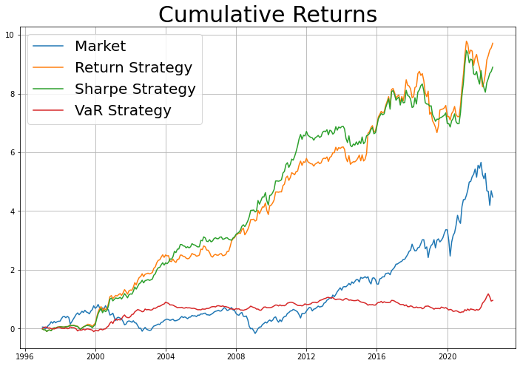
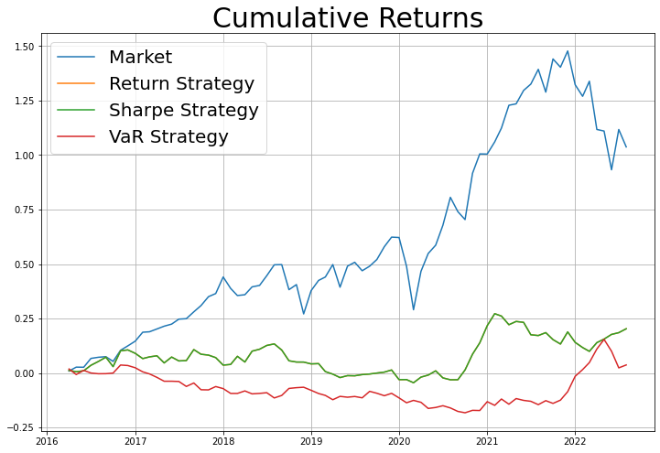
High Yield Monthly - Performance
Fit On Entire Data
Trained over multiple periods in first half then tested on 2nd half
Strategy | Return | Vol | Sharpe
Market | 6.85% | 16.1% | 0.43
Return | 9.68% | 10.82% | 0.89
Sharpe | 9.34% | 10.18% | 0.92
VaR | 2.65% | 7.75% | 0.34
Strategy | Return | Vol | Sharpe
Market | 11.73% | 16.32% | 0.72
Return | 2.92% | 9.33% | 0.31
Sharpe | 2.92% | 9.33% | 0.31
VaR | 0.57% | 8.41% | 0.07
Notes:
Entire data:
Return Strategy for cycle 1-4: ['SMB', 'SMB', 'Mom', 'RMW']
Sharpe Strategy for cycle 1-4: ['SMB', 'SMB', 'RMW', 'RMW']
Var Strategy for cycle 1-4: ['CMA', 'CMA', 'CMA', 'CMA']
Test on 2nd half:
Return Strategy for cycle 1-4: ['SMB', 'SMB', 'RMW', 'RMW']
Sharpe Strategy for cycle 1-4: ['SMB', 'SMB', 'RMW', 'RMW']
Var Strategy for cycle 1-4: ['CMA', 'CMA', 'CMA', 'CMA']

Slide 10
Machine Learning Model
2 Main Ideas to begin with:
Generate labels from Unsupervised Learning
This can be done from the macro indicator side or from the factor side, i.e.
Use macros to generate labels
Use factors to generate labels
Pipeline: Take variables -> Decompose to Principal Components -> Cluster via K-Means (4 clusters)
Once we generate labels (i.e., clusters), we can group by these to baseline performance.
Macro Factors for Clustering Model
UM Consumer Sentiment, Chi Fed. National Financial Conditions Index, Stl. Fed. Financial Stress Index, CPI, High-Yield Spread

Slide 11
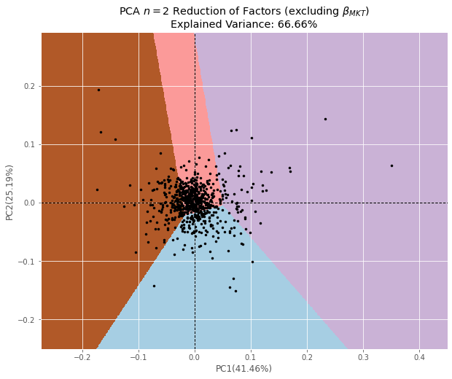
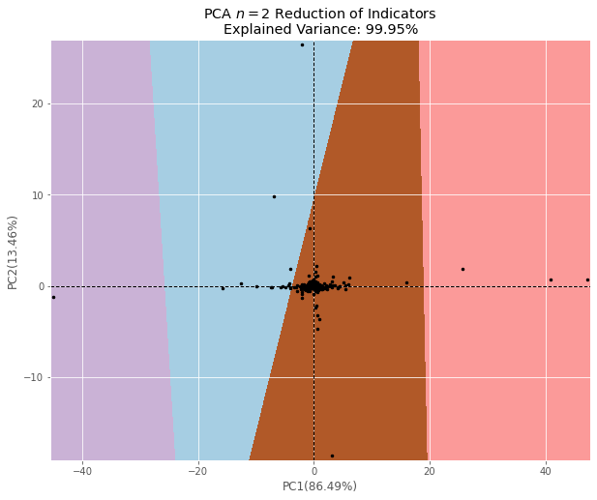
Clustering

Slide 12
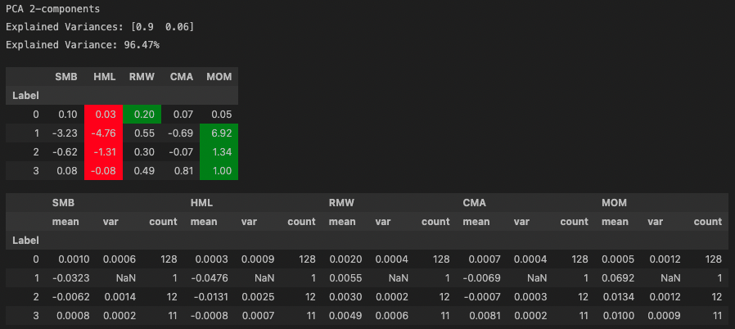
Macro-Based Clustering

Slide 13
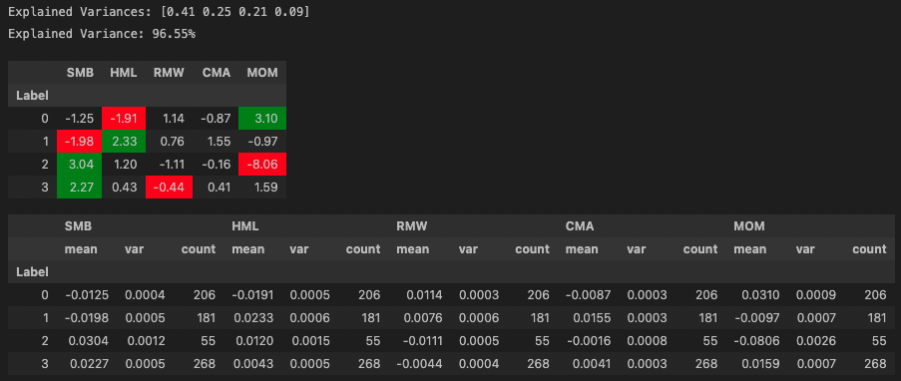
Factor-Based Clustering

Slide 14
Initial Discussion
A factor-based clustering model provides some interesting results.
PCA decomposition requires around n-1 components to explain more than 95% of variance. This makes sense because factors are diversified.
On the other side with macros, we capture a lot of variance in the first two principal components.
However, with factors, we get a dispersed set of labels
For example, from previous slide, we get 206 label 0, 181 label 1, 55 label 2, and 268 label 3.
Compared to macro-based labeling, where some labels only have 1 or 2 instances.

Slide 15
Next Steps
Finalize Economic Cycle model to have signals for trading strategy
Optimize trading strategy
Alternatives for RSR’s
Look at taking the top two factors by some weight to diversify the risk of having a factor perform not as expected.
Potentially include other factors
Expand scope beyond just FF 5 factor
Expand ML models
Look into time series clustering methods
Other ways to generate significant labels

